Slide 1

A
Project Report
on
Foundation Management System
Developed by
MODH DISHANT(IT-070) - Department of IT, DD University
JAY PANCHAL(IT-079) - Department of IT, DD University
Guided By
Internal Guide:
Prof. Archana N. Vyas
Prof. Vidhi Chaudhari
Department of Information Technology
Faculty of Technology
DD University
Department of Information Technology Faculty of Technology, Dharmsinh Desai University College Road, Nadiad-387001
October-2019
DHARMSINH DESAI UNIVERSITY

Slide 2
ACKNOWLEDGEMENT
We would like to give our sincere acknowledgement to everybody responsible for the successful completion of our project “UNIVERSITY STUDENT MANAGEMENT SYSTEM”
The success and final outcome of this project required a lot of guidance and assistance from many people and we are extremely privileged to have got this all along the completion of this project.
We owe our deep gratitude to our project guide Prof. Roshni M. Raval, who took been interest on our project work and guided us all along till the completion of our project work by providing all the necessary help for developing a good Database System.
We would also like to thank all our lecturers.
Finally we convoy our acknowledgement to all our friends and family members who directly or indirectly associated with us in the successful completion of the project.We thank one and all.

Slide 3
1.SYSTEM OVERVIEW
1.1 CURRENT SYSTEM
University Student Management System is engineered to effectively administer every aspect of a University\College Student problem which they face while entering into new University\College at any unknown place.
Any Student who enters into new University/College they face some basic and huge problem like Finding PG\Hostel, Senior Contact for some notes, College Book’s for reading or if they want to buy them, and also for eating it will show restaurants.
It will also show the different type of Activity organised by his/her particular University/College and it also show the different Event’s occurring in his/her University/College.

Slide 4
1.2 OBJECTIVES OF THE PROPOSED SYSTEM
Students can easily find Broker’s for their Living, can easily get information for nearby restaurant for their Eating.
Getting contact of their Senior form which, they can get help.
They can contact their Activity Head easily.
1.3 ADVANTAGES OF STUDENT MANAGEMENT SYSTEM
Through this system we try to achieve the below objectives
To help students by providing study material from their seniors
Students can know all the available restaurants and caters for their breakfast, lunch and dinner.
Students can explore their interest by doing activities
Students can find rent house or hostel easily.
Students can also get their second-hand study material help easily.
Also, they find Stationery and Xerox stuff easily.
By using this system students can easily figure out which stationary or restaurants or Hostels are good for them, facility wise as well as price wise.

Slide 5
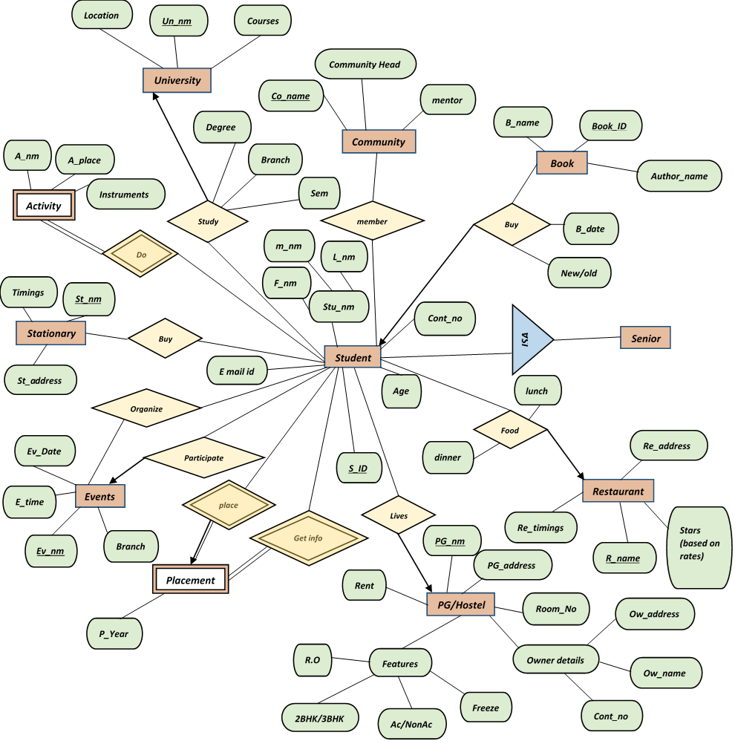
*
Manage
*
2.ER DIAGRAM
Manage
*
*
*
Manage
1
*
*
*
1
*
*
*
*
*
Manage
Username
Manage
*
*
*
*
*
Admin
*
*
*
Help
*
Manage
Password
*
*
*
*
*
1
*
Manage
1
Manage
*
*
*
*
*
*
1
Manage
*
1
*
*
Manage
*

Slide 6

3. REALATIONAL
DATA
BASE
1. University
NAME | TYPE
Universty_Name | Varchar (30) | PK
Location | Varchar (50) | NOT NULL
Courses | Varchar (20) | NOT NULL
2. Activity
NAME | TYPE
Activity_Name | Varchar (10) | NOT NULL
Activity_Place | Varchar (20) | NOT NULL
Instruments | Varchar (10) | NOT NULL
3. PLACEMENT
NAME | TYPE
Placement_Year | INT | NOT NULL

Slide 7
4. STATIONARY
NAME | TYPE
Timings | Number (5) | NOT NULL
Stationary_Name | Varchar (10) | PK
Stationary_Address | Varchar (20) | NOT NULL
5. EVENTS
NAME | TYPE
Event_Date | Date | NOT NULL
Event_Time | INT | NOT NULL
Event_Name | Varchar (10) | PK
Branch | Varchar (10) | NOT NULL
6. BOOK
NAME | TYPE
Book_Name | Varchar (10) | NOT NULL
Book_ID | Number (5) | PK
Author_Name | Varchar (10) | NOT NULL

Slide 8
7. PG/HOSTEL
NAME | TYPE
PG_Name | Varchar (20) | PK
PG_Address | Varchar (30) | NOT NULL
Room_Number | Number (5) | NOT NULL
Owner_Detail (Ow_Address) | Varchar (30) | NULL
Owner_Detail (Ow_Name) | Varchar (10) | NOT NULL
Owner_Detail (Cont_No) | Number (11) | NOT NULL
Rent | Varchar (20) | NOT NULL
Features (R.O) |  | NOT NULL
Features (2BHK/3BHK) |  | NOT NULL
Features (AC/NON.AC) |  | NOT NULL
Features (Freeze) |  | NOT NULL
8. Restaurant
NAME | TYPE
Re_Address | Varchar (30) | NOT NULL
Re_Name | Varchar (10) | PK
Re_Timing | Number (5) | NOT NULL
Star’s (Based On Review) | INT

Slide 9

9. COMMUNITY
NAME | TYPE
Mentor
Community_Head | Varchar (10) | NOT NULL
Community_Name | Varchar (10) | PK
10. STUDENT
NAME | TYPE
Student_Name (Last__Name) | Varchar (10) | NOT NULL
Student_Name (Middle_Name) | Varchar (10) | NULL
Student_Name (First_Name) | Varchar (10) | NOT NULL
Email_ID | Varchar (20) | NULL
S_ID | Varchar (10) | PK
Age | Number (3) | NOT NULL
Contact_Number | Number (11) | NOT NULL

Slide 10
11. STUDY
NAME | TYPE
Degree | Varchar (5) | NOT NULL
Branch | Varchar (10) | NOT NULL
Sem | Varchar (10) | NOT NULL
Universty_Name | Varchar (30) | FK
S_ID | Varchar (10) | FK
12. FOOD
NAME | TYPE
Dinner | Varchar (10) | NOT NULL
Lunch | Varchar (10) | NOT NULL
S_ID | Varchar (10) | FK
Re_Name | Varchar (10) | FK
13. SENIOR
NAME | TYPE
Username | Varchar (10)
Password | Varchar (15)
S_ID | Varchar (10) | FK

Slide 11
14. ADMIN
NAME | TYPE
Username | Varchar (10)
Password | Varchar (15)
Universty_Name | Varchar (30) | FK
PG_Name | Varchar (20) | FK
Re_Name | Varchar (10) | FK
Community_Name | Varchar (10) | FK
S_ID | Varchar (10) | FK
15. BUY
NAME | TYPE
Buy_date | DATE | NOT NULL
New/Old | Varchar (5)
S_ID | Varchar (10) | FK
Book_ID | Number (5)

Slide 12
University
Name
Universty_Name
Location
Courses
Placement
Name
Placement_Year
Community
NAME
Mentor
Community_Head
Community_Name
Book
NAME
Book_Name
Book_ID
Author_Name
PG/HOSTEL
NAME
PG_Name
PG_Address
Room_Number
Owner_Detail (Ow_Address)
Owner_Detail (Ow_Name)
Owner_Detail (Cont_No)
Rent
Features (R.O)
Features (2BHK/3BHK)
Features (AC/NON.AC)
Features (Freeze)
Buy
Name
Buy_date
New/Old
S_ID
Book_ID
Study
Name
Degree
Branch
Sem
Universty_Name
S_ID
Student
Sname
Student_Name (Last__Name)
Student_Name (Middle_Name)
Student_Name (First_Name)
Email_ID
S_ID
Age
Contact_Number
Senior
Name
Username
Password
S_ID
Activity
Name
Activity_Name
Activity_Place
Instruments
Admin
Name
Username
Password
Universty_Name
PG_Name
Re_Name
Community_Name
S_ID
Food
NAME
Dinner
Lunch
S_ID
Re_Name
Stationary
Name
Timings
Stationary_Name
Stationary_Address
Events
Name
Event_Date
Event_Time
Event_Name
Branch
Restaurant
NAME
Re_Address
Re_Name
Re_Timing
Star’s (Based On Review)

